Slide 1

DATA QUEST – Unlocking the
Power of Data
Case Study Challenge 2023
Statistics Track – Final Round
From fork to fitness!
Shreya Wahi
Dega Balaji Vara Prasad
Exploring the Relationship Between Eating Patterns and Obesity
Sankhadeep Kundu
Pondicherry University
Notes:
Title slide
Front page
First page
Life-changing careers
China

Slide 2
Idea Generation
Focus on [1.1]
We were provided information about a year-long, double-blinded study on 564 teens with obesity. Phase 2 Testa trial was a huge success that proved Testa 1mg to be clinically effective in reducing body weight.
To proceed with the Phase 3 Testa trial study, we needed to simulate data on 564 subjects based on given parameters. The study participants were supposed to be randomly allocated to groups receiving Testa 1mg, Testa 2mg and Placebo in a 1:2:1 manner.
We generated normally distributed random data for all subjects of each of the 3 groups, based on their given parameters. In order to maintain a 15% dropout rate of subjects, we induced random missingness in the data according to the given pattern.
Finally, the simulated data is obtained for 564 patients at baseline visit, with a 15% dropout rate by the end of the 52-week study.
NOTE: During the random generation of data, a seed value of 12345 was used to maintain the same data for the study. The same seed value was used while creating a random missingness pattern to address the 15% dropout rate.

Slide 3
Data Summary
Data Preparation:
To begin with our Phase 3 Testa trial study, we needed complete data of subjects, devoid of any missing observation. We used the idea of K-Nearest Neighbors to impute the missing data. We split the complete data in the manner of 1:2:1 for 3 distinct tests. Imputation of missing data was carried out for individual tests.
Challenges with the data:
a) The data was generated based on normal distribution. Hence, we had values for both the Questionnaire Scores that were out of pre-defined bounds. In order to fit a real-life scenario, we limited the out-of-bounds values by their extremes. This was done under the assumption that there was no error in data collection, in case the data was collected in real life.
b) Due to simulation, we observed a few subjects that had major fluctuations, across the 4 visits, in their Questionnaire Scores, BMI, Body Weight and Waist Circumference. The cause of such fluctuation lies in the basis of data simulation and the seed value used.
Such fluctuations are unexpected in a real-life scenario. Rapid rise and fall in subjects’ data is usually not found in real-life data. After handling the possible anomalies in the data, after simulation, we obtained complete data. We had 0 missing values, with all variables under study within their respective limits.

Slide 4
Statistical Methodology
KNN Imputation
Shapiro Wilk Test for Normality
The Chi-Square Test of Independence
Friedman Test
To estimate the missing values for the subjects based on the K-nearest identical subjects that have complete data.
To check if the variables under study are normally distributed, after rectifying the data.
To determine if there exists any association or statistically significant difference in the proportion of healthy subjects brought about by the 2 variants of Testa.
To determine if there’s a statistically significant difference between the means of the respective study variable for the same subject across all the 4 visits.

Slide 5
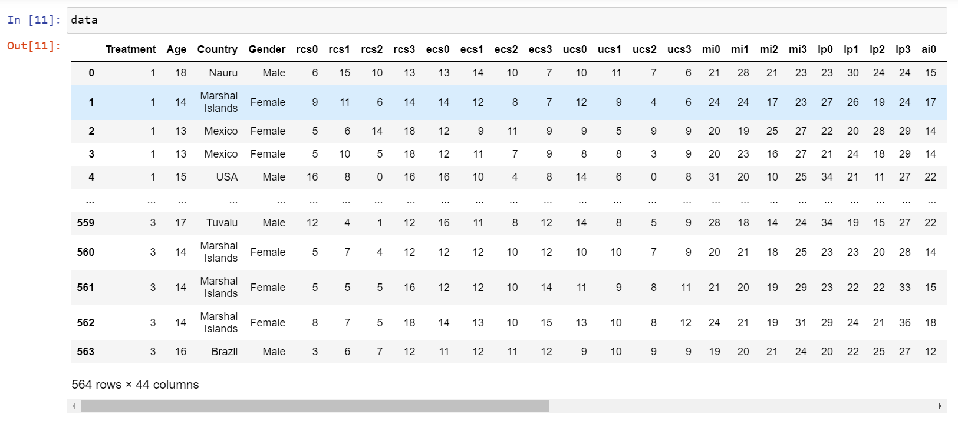
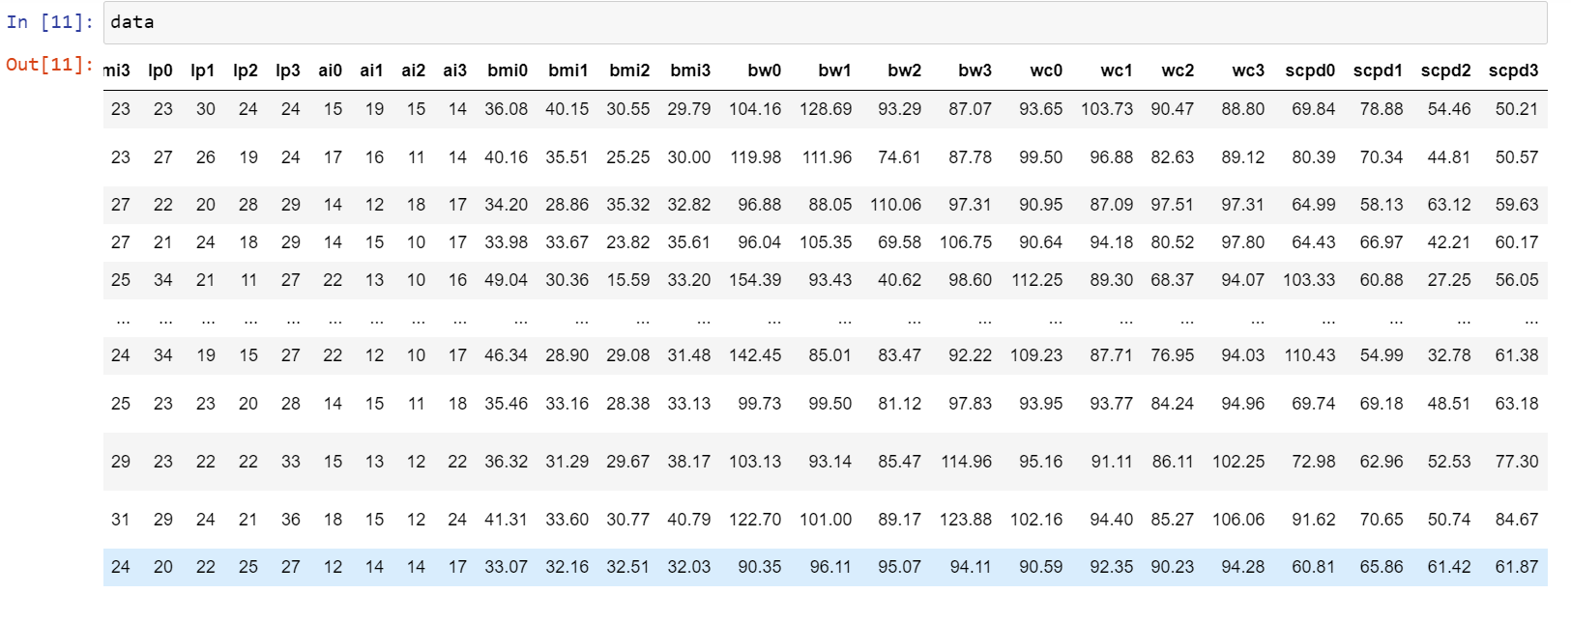
Snapshots of the data generated

Slide 6
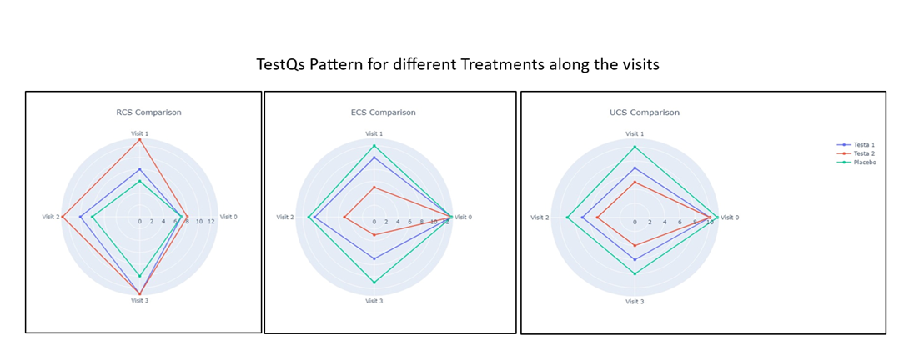
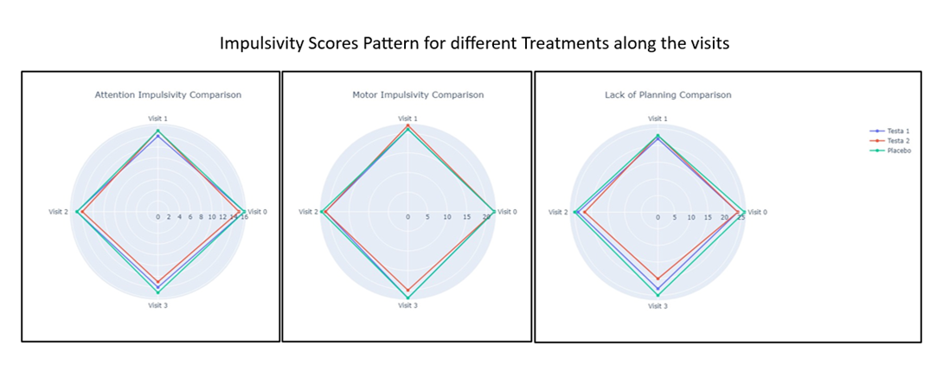
Questionnaire based analysis For [1.2]
Friedman’s Test for Test-Q and Impulsivity Scores:
Friedman's Test Results |  |  | Post Hoc Results: (not a significant Change from)
RCS | Testa 1 mg | singificant | : Visit 1 to Visit2
 | Testa 2mg | significant | : Visit 1 to Visit 2 & Visit 2 to Visit 3
 | Placebo | significant | : Visit 1 to Visit2
ECS | Testa 1 mg | significant | : Visit 1 to Visit2
 | Testa 2mg | significant | : Visit 1 to Visit2
 | Placebo | significant | : Visit 0 to Visit 1 & Visit 2 to Visit 3
UCS | Testa 1 mg | significant | : Visit 1 to Visit2
 | Testa 2mg | significant | : Visit 1 to Visit2
 | Placebo | significant | : significant decrease in all visits :
Attention Impulsivity | Testa 1 mg | significant | : Visit 1 to Visit2
 | Testa 2mg | significant | : Visit 1 to Visit 2 & Visit 2 to Visit 3
 | Placebo | significant | : Visit 1 to Visit 2 & Visit 2 to Visit 3
Motor Impulsivity | Testa 1 mg | in -significant | ::
 | Testa 2mg | significant | : Visit 1 to Visit 2 & Visit 2 to Visit 3
 | Placebo | in-significant | ::
Lack of Planning | Testa 1 mg | in-significant | ::
 | Testa 2mg | significant | : Visit 1 to Visit2
 | Placebo | in-significant | ::
Interpretation: Testa 2mg works the best in reducing the ECS and UCS and increasing RCS through the 4 visits.
We can observe that Testa 2mg controls the scores rather smoothly than Testa 1mg. The insignificant change after visit1 shows that Testa 2 mg controls the scores in the first visit itself.
Interpretation : Any of the treatment has no such effect in controlling the impulsivity scores. However, Testa 2 mg still reduces the scores a little in comparison to Testa 1 mg.

Slide 7
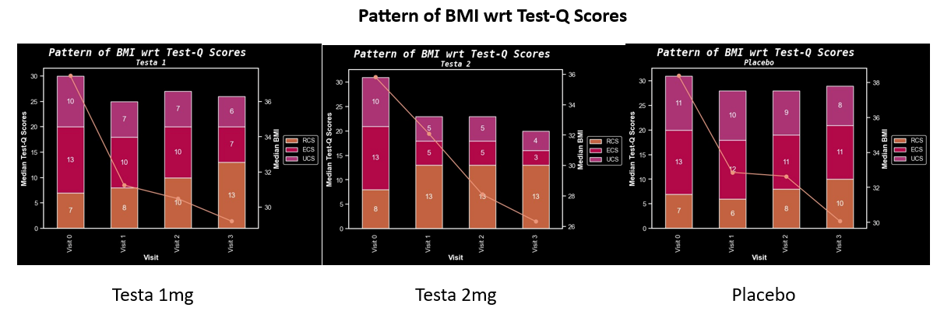
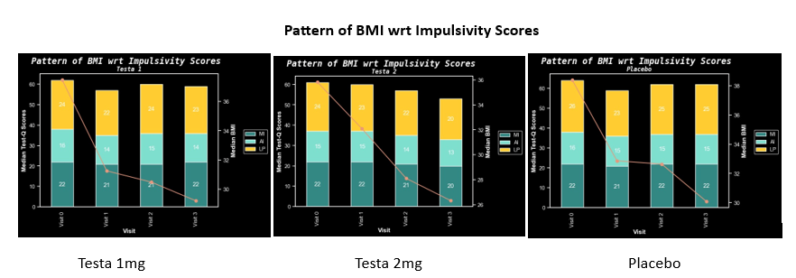
For [1.2]
It can be observed that as the UCS and ECS decreases and the RCS increases, the BMI decreases along the different visits. This tells us that the eating behavior effects the BMI of a patient.
However, as there is not much difference in the impulsivity scores, the BMI still decreases.
Further, from the correlation matrix of different scores , we can conclude that the impulsive behavior of a patient does effect their eating behavior significantly.

Slide 8
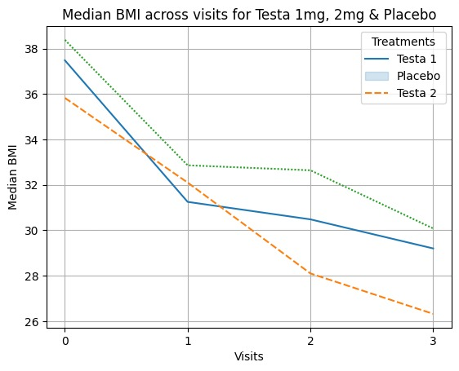
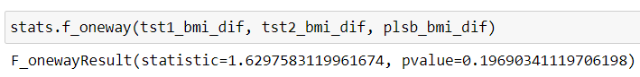
Primary endpoint analysis! For [1.3]
A test for the mean drop in BMI (difference of BMI from visit0 to visit3) for all the three treatments was conducted. However there is no significant difference in the drop of BMI.
Further, Friedman’s test was conducted to see how the BMI changed for the treatments across the visits.
Friedman's Test Results |  |  | Post Hoc Results: (not a significant Decrease from)
BMI | Testa 1 mg | significant | : Visit 1 to Visit 2 & Visit 2 to Visit 3
 | Testa 2mg | significant | : significant decrease in all visits :
 | Placebo | significant | : Visit 1 to Visit2
From the above results and the profile plot, we can observe that Testa 2mg brought the BMI down significantly through all the visits. While Testa 1mg, dropped the BMI in the first visit, but there was no significant drop in the further visits.

Slide 9
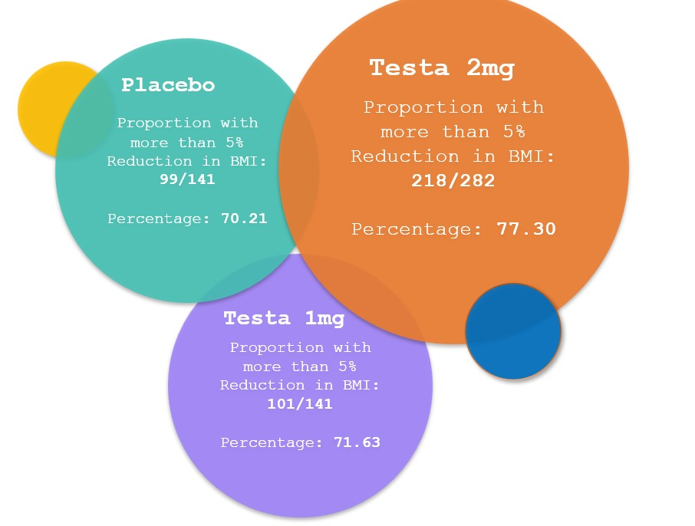
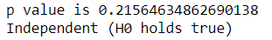
Primary endpoint analysis! For [1.4]
Checking how many patients dropped at least 5% body weight at the end of the treatments.
 | dropped 5% body weight | did not drop 5% body weight | total | proportion of patients who dropped 5% body weight
Testa 1mg | 101 | 40 | 141 | 0.716
Testa 2mg | 218 | 64 | 282 | 0.773
Placebo | 99 | 42 | 141 | 0.702
We applied chi-square test to check the difference between the proportions of the three groups:
From above p-value, we can conclude that there is no statistical difference in the proportion of patients who dropped 5% body weight under different treatments. However looking at the numbers, we can say that Testa 2mg helped more people to drop the weight.

Slide 10
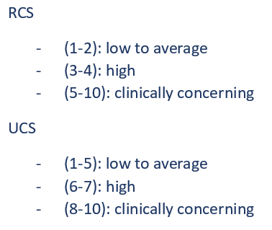
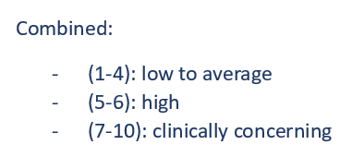
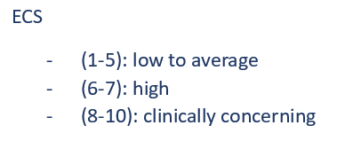
Combined Test-Q and Impulsivity Scores. For [2.1]
For Test-Qs Scores:
First all the scores were upscaled
RCS (0-21) was upscaled to (1-22)
UCS (0-14) was upscaled to (1-15)
ECS (0-16) was upscaled to (1-17)
Then all the scores were brought to scale of 1- 10 using weights
RCS = (22-x)*10/22 [RCS is reversed by subtracting it from the maximum and then scaled.]
UCS = x*10/15
ECS = x*10/17
After all the scores are brought into the scale of 1-10 .
A new scale is formed using the average of these 3 scores.
Higher the score, higher the risk of obesity
Test-Qs
For the impulsivity scores for 10 questions each:
Attention impulsivity : (10-40)
Motor impulsivity : (10-40)
Lack of planning : (10-40)
The combined scale for impulsivity scores can be combined and reduced:
Combined Scale: (30-120) reduced to:
10-20 (occasional)
20-30 (often)
30-40 (Always)
Higher the score, higher the risk of obesity
Impulsivity scores
10
20
30
40

Slide 11
Sugar Tax Policy. For [2.2]
Using correlation analysis, we can see that their high correlation of sugar consumption with BMI (visit wise), indicating the more the sugar intake(not necessarily implying causation), the higher the risk for obesity.
1. To enhance the public health impact, revenue generated from the tax could be directed towards funding health education campaigns, promoting physical activity programs in schools, and subsidizing healthier food options in government provided meal schemes.
2. Engage in an interaction with beverage manufacturers and other stakeholders to find a balance between taxation and supporting the industry's transition toward healthier products. Consider offering incentives for product reformulation and diversification.

Slide 12
Summary:
- From the overall analysis , we can conclude that Testa 2mg is working better in controlling the BMI as well as the eating behavior and impulsivity score.
- Considering the placebo as the basis, Testa 2mg is bringing better and smoother results in combating the problem of obesity than Testa 1mg.
Recommendations/Scope:
- If proper data on demographics is given, further study on the effect of treatments on age, gender and country can be done.

Slide 13
References:
https://www.statology.org/
https://stackoverflow.com/
https://pandas.pydata.org/
https://matplotlib.org/
https://plotly.com/python/
https://www.geeksforgeeks.org/
https://real-statistics.com/anova-repeated-measures/friedman-test/friedman-test-post-hoc-analysis/
https://www.hsph.harvard.edu/nutritionsource/healthy-drinks/sugary-drinks/

